Slide 1
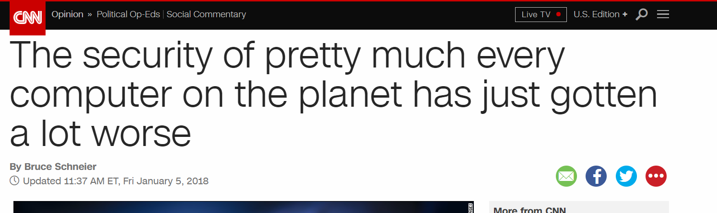
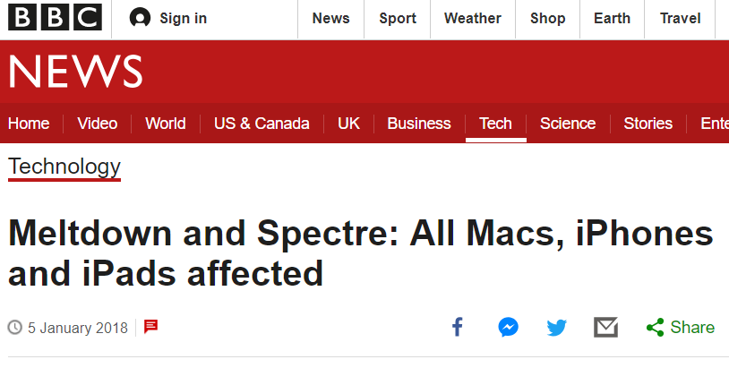


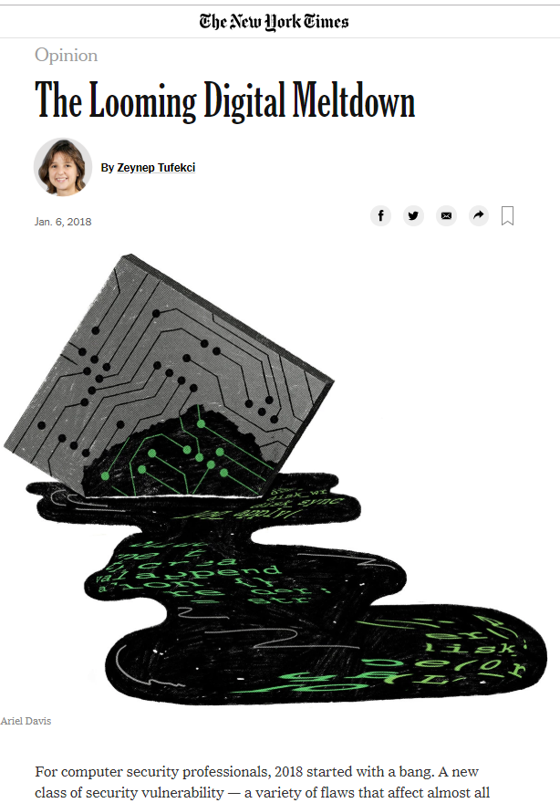

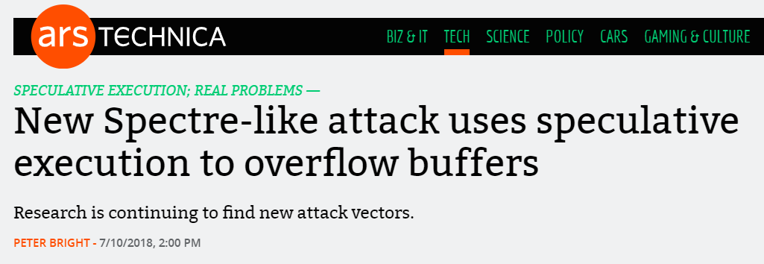
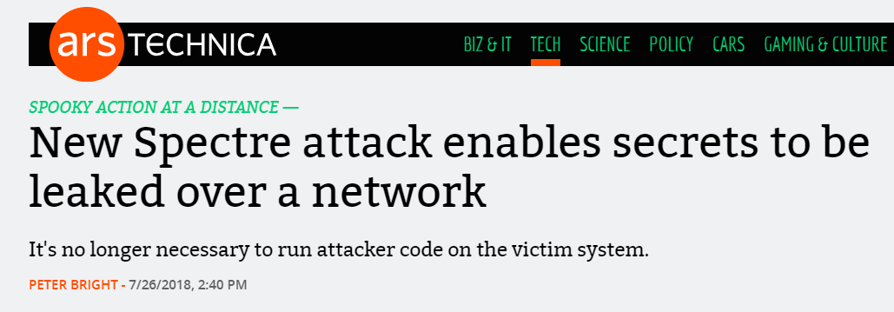
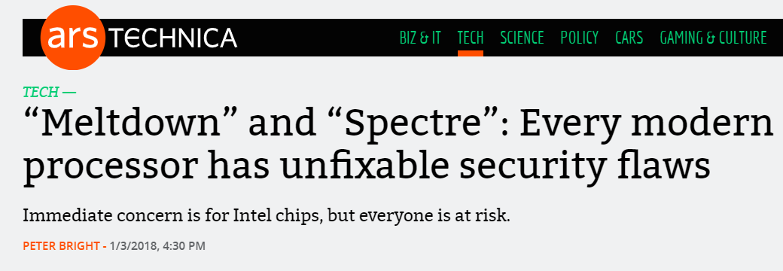

Slide 2
Two microarchitecture techniques
Caches
Keep “useful” things closer to processor

Slide 3
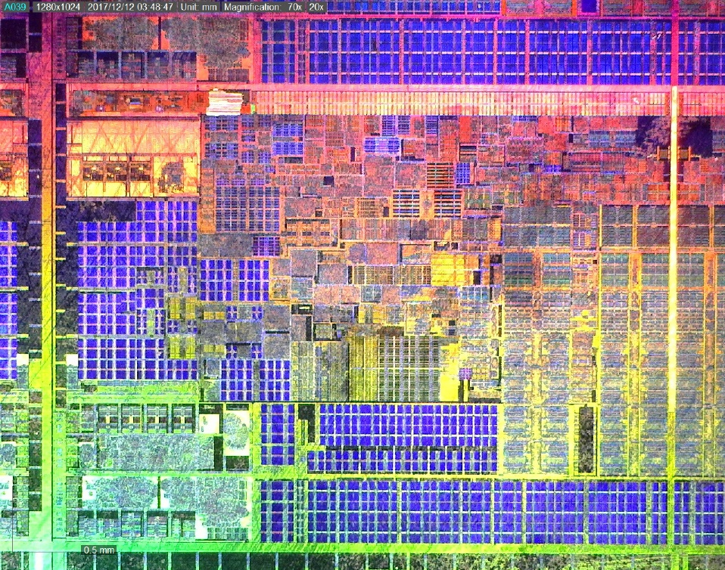
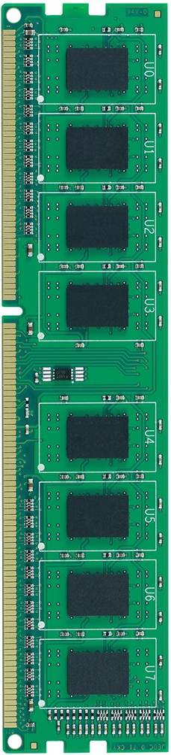
Two microarchitecture techniques
Caches
Keep “useful” things closer to processor
0xAB140
0xAB140
0xAB180
 | Way 0 | Way 1
Set 0
Set 1
Set 2
Set 3
0xAB140
0xAB180
0xAB140
0xAB140
0xAB180

Slide 4
Two microarchitecture techniques
Caches
Keep “useful” things closer to processor
Cache hits are fast and misses are slow
Out of order execution
Instructions can execute even if previous instructions haven’t
 | Way 0 | Way 1
Set 0
Set 1
Set 2
Set 3
0xAB140
0xAB140
0xAB140
0xAB180

Slide 5
Two microarchitecture techniques
Out of order execution
Instructions can execute even if previous instructions haven’t
size = *size_ptr;
if (x < size) {
y = array[x];
}
mov %rax, [%rcx]
cmp %rax, %rbx
jge END
mov %rcx, [%rbx]

Slide 6
Two microarchitecture techniques
Caches
Keep “useful” things closer to processor
Cache hits are fast and misses are slow
Out of order execution
Instructions can execute even if previous instructions haven’t
Can speculate, but will always “commit” correctly
size = *size_ptr;
if (x < size) {
y = array[x];
}
mov %rax, [%rcx]
cmp %rax, %rbx
jge END
mov %rcx, [%rbx]

Slide 7
Virtual memory
Kernel Space
0xFFFFFFFF
0xC0000000
char *addr = 0xFFFF0000;
char *array[256 * 512];
char temp = 0xFF;
char secret = *addr;
temp &= array[secret];
Stack
Heap
Code
0x00000000

Slide 8


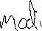
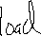

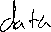
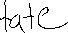

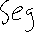

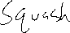
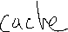
rcx
char *addr = 0xFFFF0000;
char *array[256 * 512];
char temp = 0xFF;
char secret = *addr;
temp &= array[secret];
rbx
retry:
mov al, [rcx]
shl rax, 0xc
jz retry
mov rbx, [rbx + rax]
...
rax
https://github.com/IAIK/meltdown

Slide 9

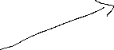



char *addr = 0xFFFF0000;
char *array[256 * 512];
char temp = 0xFF;
char secret = *addr;
temp &= array[secret];
retry:
mov al, [rcx]
shl rax, 0xc
jz retry
mov rbx, [rbx + rax]
...
...
for (i=0; i<256; i++) {
t = time(array[i])
if (t < 80) // Hit!
...
 | Way 0 | Way 1
Set 0
Set 1
Set 2
Set 3
. . .

Slide 10
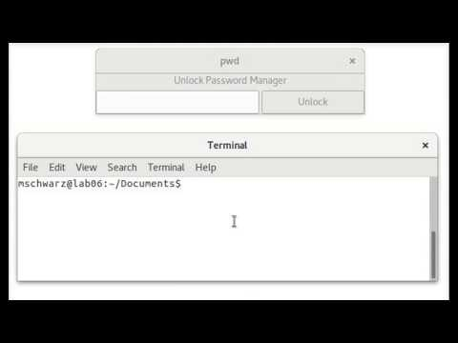
https://www.youtube.com/watch?v=RbHbFkh6eeE

Slide 11
Similar attacks
Meltdown: Ignores page table permissions
LazyFPU: Ignores floating point disabled
Foreshadow or L1 terminal fault: Ignores lots of permissions
Virtual machine
Security extensions (SGX)
Others???

Slide 12
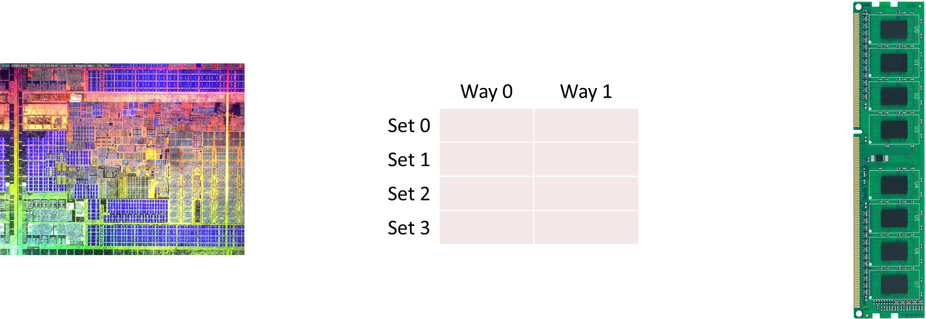
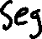
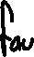

Assumptions
Every instruction executes “atomically”
Permissions checks may happen late
Memory operations take the same amount of time
Caches are not invisible
mov al, [rcx]
Notes:
Write: Key problem: difference between architectural state and microarchitectural state
What is this???

Slide 13
size_t array1_size = 16;
uint8_t array1[array1_size] = {0,1,2,...,15};
uint8_t array2[256 * 512];
void victim_function(size_t x) {
if (x < array1_size) {
temp &= array2[array1[x] * 512];
}
}
Notes:
Introduce branch prediction here!

Slide 14
void victim_function(size_t x) {
if (x < array1_size) {
temp &= array2[array1[x] * 512];
}
}
https://gist.github.com/ErikAugust/724d4a969fb2c6ae1bbd7b2a9e3d4bb6
Notes:
We’ll come back to this in a minute, but first, let’s simplify further.
So, this code is put through a compiler, and assembly/instructions are generated.

Slide 15
000000000040105e <victim_function>:
40105e: push %rbp
40105f: mov %rsp,%rbp
401062: mov %rdi,-0x8(%rbp)
401066: mov 0x2bf014(%rip),%eax
40106c: mov %eax,%eax
40106e: cmp -0x8(%rbp),%rax
401072: jbe 40109f <victim_function+0x41>
401074: mov -0x8(%rbp),%rax
401078: add $0x6c00a0,%rax
40107e: movzbl (%rax),%eax
401081: movzbl %al,%eax
401084: shl $0x9,%eax
401087: cltq
401089: movzbl 0x6c1d80(%rax),%edx
401090: movzbl 0x2e0ce9(%rip),%eax
401097: and %edx,%eax
401099: mov %al,0x2e0ce1(%rip)
40109f: pop %rbp
4010a0: retq
void victim_function(size_t x) {
if (x < array1_size) {
temp &= array2[array1[x] * 512];
}
}
https://gist.github.com/ErikAugust/724d4a969fb2c6ae1bbd7b2a9e3d4bb6
Notes:
Explain this is called in a loop. First with x values in the range to warmup the BP then with one outside the range.

Slide 16
void victim_function(size_t x) {
if (x < array1_size) {
temp &= array2[array1[x] * 512];
}
}
000000000040105e <victim_function>:
40105e: push %rbp
40105f: mov %rsp,%rbp
401062: mov %rdi,-0x8(%rbp)
401066: mov 0x2bf014(%rip),%eax
40106c: mov %eax,%eax
40106e: cmp -0x8(%rbp),%rax
401072: jbe 40109f <victim_function+0x41>
401074: mov -0x8(%rbp),%rax
401078: add $0x6c00a0,%rax
40107e: movzbl (%rax),%eax
401081: movzbl %al,%eax
401084: shl $0x9,%eax
401087: cltq
401089: movzbl 0x6c1d80(%rax),%edx
401090: movzbl 0x2e0ce9(%rip),%eax
401097: and %edx,%eax
401099: mov %al,0x2e0ce1(%rip)
40109f: pop %rbp
4010a0: retq
load array1_size
401066: mov 0x2bf014(%rip),%eax
if (x < array1_size)
401072: jbe 40109f <victim_function+0x41>
load array1[x]
40107e: movzbl (%rax),%eax
load array2[array1[x] * 512]
401089: movzbl 0x6c1d80(%rax),%edx
Modifies addresses present in L1 cache
Notes:
Go faster

Slide 17

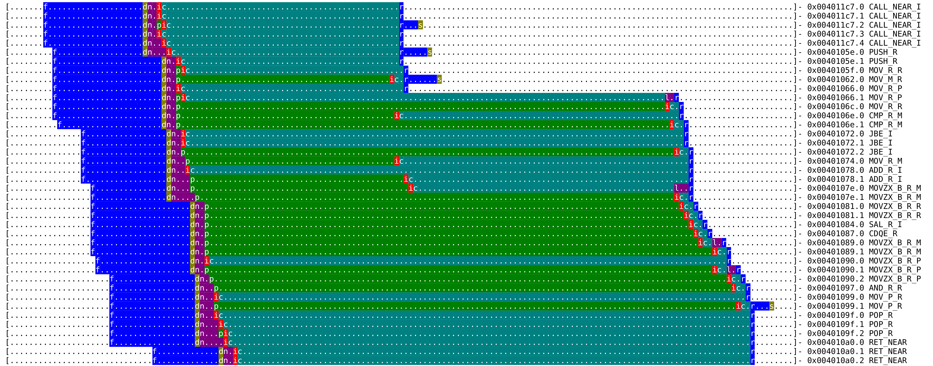

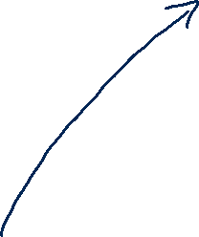



Branch correctly predicted
Time
if (x < array1_size)
load array1_size
http://bit.ly/gem5-spectre
load array1[x]
load array2[array1[x] * 512]
Notes:
Add: BRANCH CORRECTLY PREDICTED NOT TAKEN

Slide 18



Branch incorrectly predicted
Time
if (x < array1_size)
load array1_size
load array1[x]
load array2[array1[x] * 512]
Notes:
Add: BRANCH INCORRECTLY PREDICTED NOT TAKEN

Slide 19
Similar attacks
Spectre v1: ignores bounds check
Spectre v2: jumps to random locations
Spectre v4: forwards store data incorrectly
Many, many others
Notes:
We’ll come back to this in a minute, but first, let’s simplify further.
So, this code is put through a compiler, and assembly/instructions are generated.

Slide 20
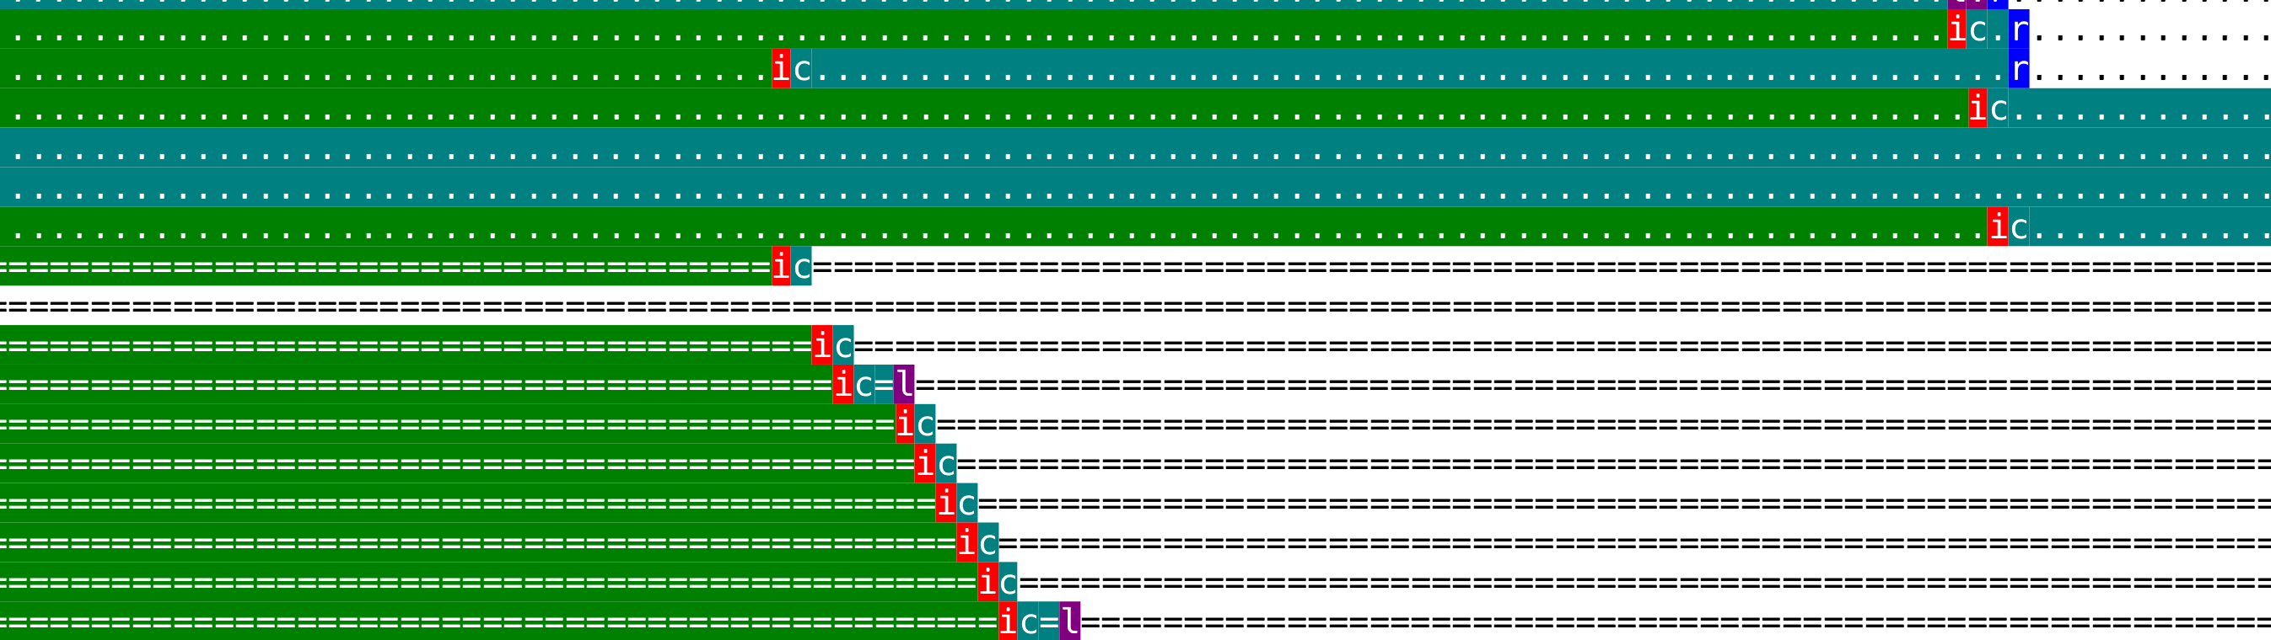
Assumptions
Instructions execute in order
Can “predict” what code to execute
Memory operations take the same amount of time
Caches are not invisible
Notes:
Again add “assumpt8ion” “actually” here. Also may the first picture better?

